Slide 1
SwiftLog Logistics Analytics and AI Transformation
Dineo Nadine Sithole | Experience Lab Intern, Machine Learning Track
Notes:
Open with the headline: we built four models for SwiftLog and tested them properly. The honest answer is that none of them beats a simple baseline yet, and the data analysis still gives SwiftLog clear actions.

Slide 2
SwiftLog loses time and money before any model is involved
63.7%
32.5%
34.3%
~150
of shipments delayed by 3+ days
of orders cancelled
of orders still Pending
months of stock cover
mean delay 3.6 days
33.4% of ordered value
88% older than 30 days
1.0M units vs 6.7k sold a month
Delay, cancellation and backlog levels are similar across every warehouse and city, so they look like system-wide process issues rather than one bad location.
Notes:
These four numbers come straight from the original CSVs, no modelling. 63.7% of 5,000 shipments were delayed by 3+ days. A third of orders are cancelled and a third are Pending, most of them stale. Stock cover is about 150 months, which means overstocking, not shortage.

Slide 3
We set out to predict four logistics outcomes
Delivery delay
Classification
Demand forecasting
Regression
Target: Shipment delayed 3+ days (1) or not (0)
Target: Units sold per product next month
Data: 5,000 shipments
Data: 1,500 product-months
Tables: Orders, Order_Items, Products, Customers, Shipments, Delivery_Performance, Warehouses
Tables: Orders, Order_Items, Products, Inventory
Customer value
Regression
Warehouse performance
Regression
Target: Spend in June to August from Jan to May behaviour
Target: Delay rate of a warehouse in a month
Data: 1,000 customers
Data: 105 warehouse-months
Tables: Customers, Orders, Order_Items, Products
Tables: Warehouses, Inventory, Shipments, Delivery_Performance, Orders, Order_Items
Not built: supplier reliability (no table links suppliers to shipments or products) and product returns (Returns.csv was not provided). Delay prediction replaces supplier reliability.
Notes:
Be upfront about scope. We swapped supplier reliability for delivery delay because the data cannot support it, and returns were not in the files.

Slide 4
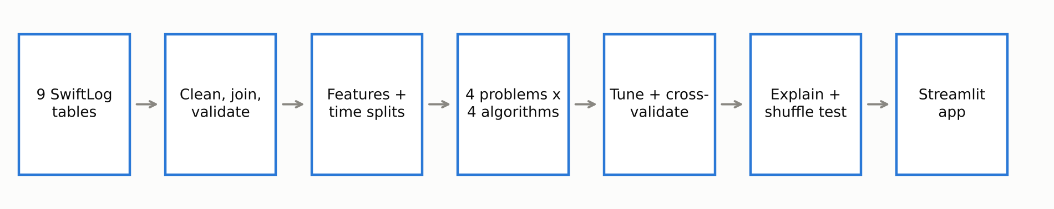
How we built and tested the models
Leakage guarded
Time-based splits
Baselines first
Delay Status comes from DelayDays, so it was never a feature. Current-month warehouse delay (r = 0.85 with its target) was dropped.
Train on earlier months, test on later ones. Customer value uses Jan to May behaviour to predict Jun to Aug spend.
Every model is compared with predicting the majority class or the average. A model must beat that to be useful.
Notes:
Three algorithms per problem (logistic or ridge regression, random forest, gradient boosting), tuned with cross-validation that respects time order.

Slide 5
EDA: no feature is strongly tied to any target
What this means
A value of 1 would be a perfect link; these are all close to 0.
Warehouse is highest, but from only 105 rows.
Caught a leak: current-month warehouse delay days (r = 0.85) would have looked great and been useless, so it was excluded.
Outliers were kept: at most 2.2% of values.
Notes:
Correlation axis runs 0 to 1 so the small bars are not exaggerated. The leakage catch is a good example of why we check before modelling.

Slide 6
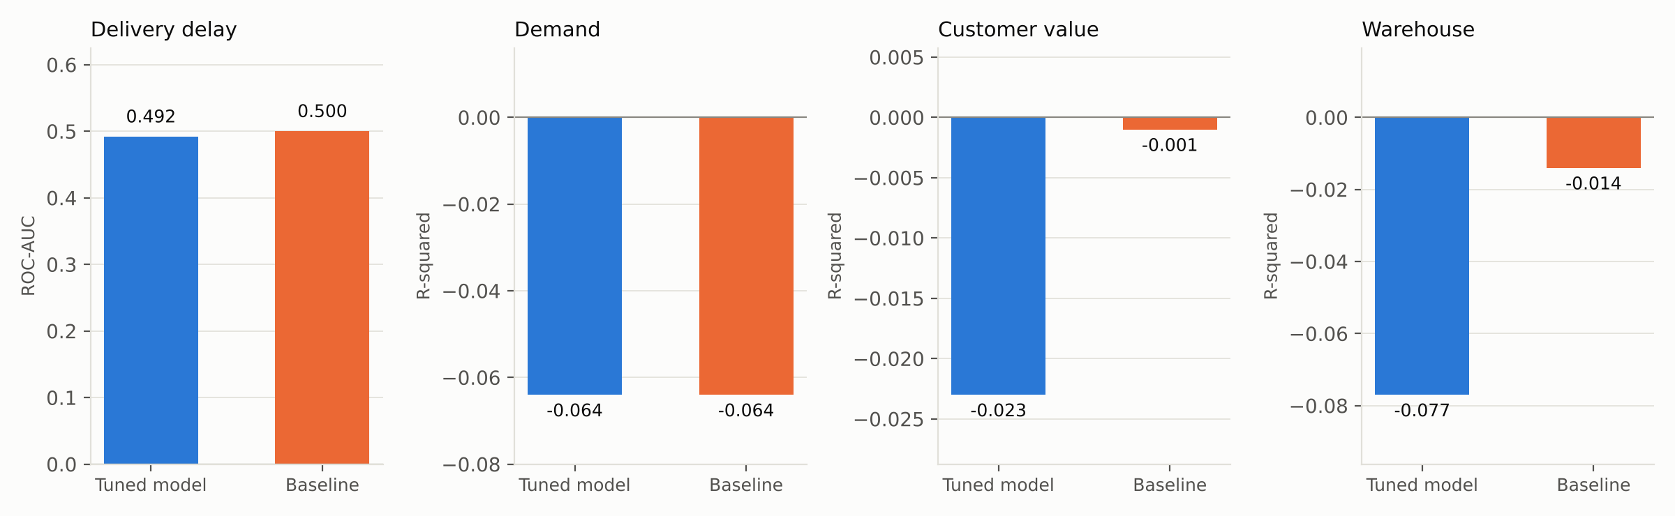
On unseen data, no model beats its baseline
Tuned models match or trail the no-skill baseline on every problem. Delay AUC is 0.492 (0.5 is a coin flip). Demand, customer and warehouse R-squared are all at or below zero, which means no better than predicting the average.
Notes:
This is the key result. Say it plainly: we do not recommend deploying these models for decisions.

Slide 7
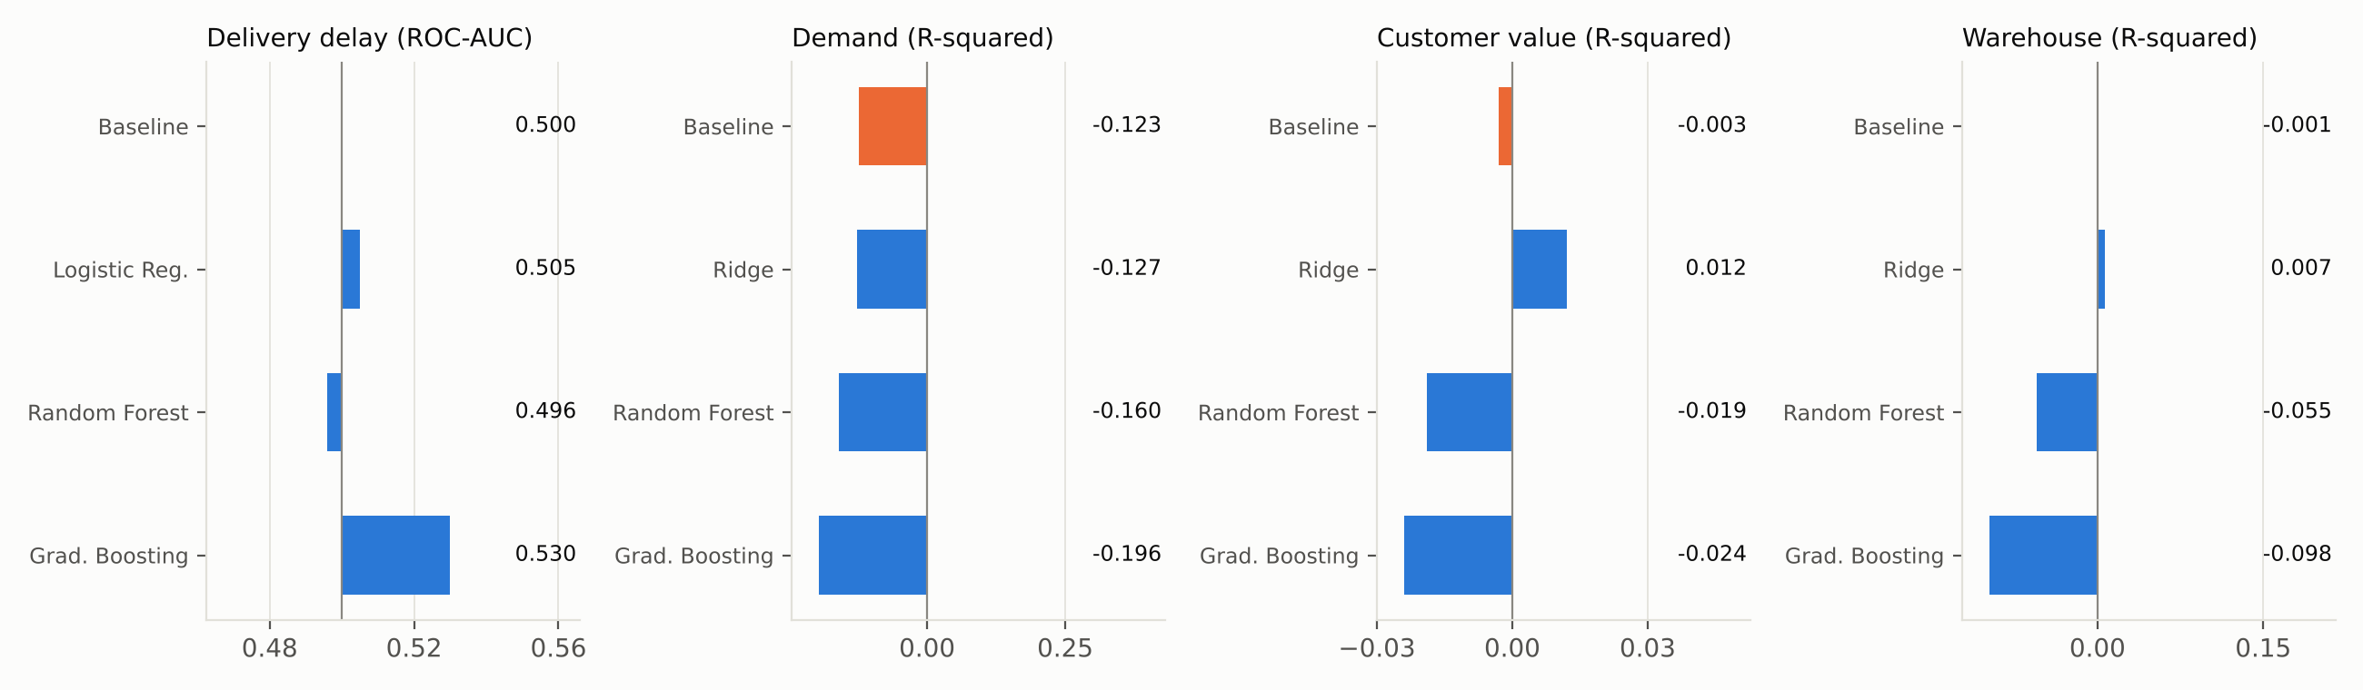
Three algorithms per problem, no clear winner
Cross-validated scores for all three algorithms sit within noise of the baseline. Delay CV AUC was 0.513 plus or minus 0.023, about 0.6 standard errors from chance. Warehouse RMSE is 0.072 for all three.
Notes:
Model choice made almost no difference, which tells us the limit is the information in the data, not the algorithm.

Slide 8
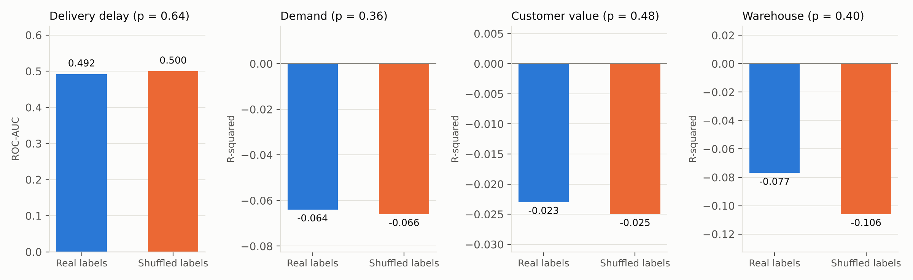
Is it just chance?
We shuffled the real answers 1,000 times. The model's real score is not better than what shuffling produces: p = 0.64 (delay), 0.36 (demand), 0.48 (customer), 0.40 (warehouse). A result needs p below 0.05 to count as real signal.
The delay model labelled 490 of 491 delayed shipments correctly but found only 1 of 259 on-time shipments: it effectively says 'Delayed' for everything. Accuracy by warehouse (0.56 to 0.82) is noise on small groups.
Notes:
The 65.5% accuracy looks decent until you see the baseline gets the same by always saying Delayed.

Slide 9
What the models rely on is small and unstable
Top SHAP drivers (average contribution)
2 of 45
Delay: order_value 0.20, total_qty 0.13, order_dow 0.07
Demand: UnitPrice 0.42, total_stock 0.37, Category_Fashion 0.12
Customer: share_Food 504, total_spend 463, tenure_days 318 (permutation and SHAP disagree)
Warehouse: lag_avg_delay_days, n_low_stock, WarehouseCity_Kano (about plus or minus 0.02)
features were clearly above zero in permutation importance (customer value only: n_cancelled and n_orders_all).
Delay 0 of 13, demand 0 of 8, warehouse 0 of 9.
A model that is not better than chance will still rank features. These rankings describe the model, not the world, and must not be read as causes.
Notes:
Permutation importance and SHAP use different methods and disagree for the customer model, another sign the signal is weak.

Slide 10
What the data shows without any model
Pending backlog
Cancelled orders still ship
Network mismatch
1,716 orders are Pending; 87.8% are older than 30 days and 63.5% older than 90 days.
All 1,626 cancelled orders have a shipment, and 64.5% of those are labelled Delayed.
75.1% of shipments are cross-city. Lagos holds 53.4% of stock; Ibadan has no warehouse.
Overstock, thin spots
Customer concentration
Data gaps
About 150 months of cover overall, yet 142 of 2,455 warehouse-product pairs hold under 50 units (3 are zero).
The top 10% of customers hold 23.9% of value, and 29.5% had no spend from June to August.
236 orders have no items, and no table links suppliers to shipments or products.
Notes:
These are facts computed from the raw tables. They are descriptive, and they are where the recommendations come from.

Slide 11
Recommendations 1 to 6: fix the operation
1
Make on-time delivery a tracked headline KPI
2
Record the data that could explain delays
Report the delayed share weekly by warehouse and city, and set a service target (suggested: below 40% within two quarters).
Capture carrier, route and distance, dispatch and delivery timestamps, handling time and weather. Re-test once 3 to 6 months of this data exists.
KPI: Delayed share, mean delay days | 0 to 3 months
KPI: Share of shipments with complete tracking data | 0 to 6 months
3
Clear and police the Pending backlog
4
Stop creating shipments for cancelled orders
Add ageing rules: escalate after 7 days, auto-review at 30 days, and report Pending age in the weekly dashboard.
Fix the order workflow so cancellation closes the shipment, and flag cancelled orders in delay reporting.
KPI: Pending orders older than 30 days | 0 to 3 months
KPI: Cancelled orders with an open shipment (target 0) | 0 to 3 months
5
Find out why a third of orders are cancelled
6
Align the warehouse network with where customers are
Add a mandatory cancellation reason code (stock, payment, delivery promise, customer change) and review it monthly.
Pilot nearest-warehouse dispatch rules and assess an Ibadan micro-hub. Measure cost and transit time, because delay did not differ between same-city (63.9%) and cross-city (63.7%) shipments.
KPI: Cancellation rate, by reason | 0 to 3 months
KPI: Share of same-city shipments, cost per shipment | 3 to 9 months
Notes:
Each recommendation links to a number on the findings slide, has a named KPI and a time horizon. Full evidence is in the technical report.

Slide 12
Recommendations 7 to 12: fix the data and the AI
7
Right-size inventory
8
Rebalance stock between warehouses before reordering
Verify that stock and order quantities use the same unit, then pause replenishment and set min/max reorder points to release working capital.
Transfer surplus stock to low-stock locations, and raise a transfer request automatically when a pair falls below a threshold.
KPI: Months of cover per product, stock value | 0 to 6 months
KPI: Warehouse-product pairs below 50 units | 0 to 3 months
9
Do not let the current models drive decisions
10
Enrich customer data before predicting customer value
Use the Streamlit app as a prototype only. Set an acceptance gate before any model is used: beat the baseline on a time-ordered test set and pass the shuffle test at p below 0.05.
Add segment, acquisition channel, payment method and returns, then run reactivation experiments (A/B tests) to learn what works instead of predicting spend.
KPI: Model vs baseline on a held-out period | Ongoing
KPI: Reactivation rate of lapsed customers | 3 to 9 months
11
Link suppliers to products and shipments
12
Forecast demand at category level until richer data exists
Add SupplierID to Products and Shipments, with purchase-order, promised and received dates and quality outcomes.
Plan with category-level monthly forecasts plus safety stock, and capture promotions, price changes and stock-outs. Revisit product-level forecasting with 12 or more months of data.
KPI: Share of shipments with a supplier link | 0 to 6 months
KPI: Forecast error at category level | 3 to 9 months
Notes:
Recommendation 9 is the important one for this project: do not let the current models drive decisions.

Slide 13
Future AI roadmap: earn the right to predict
Phase 1: Foundations
Phase 2: Better data
Phase 3: Earned models
0 to 3 months
3 to 9 months
9 to 18 months
Weekly KPI dashboard: delayed share, Pending age, cancellations, cover
Fix cancelled-order shipments and add cancellation reason codes
Data-quality checks on every feed (duplicates, orders without items, stale Pending)
Capture carrier, route, timestamps and weather; add SupplierID links
Statistical demand plan at category level with safety stock
Reorder points and stock transfers across warehouses
Delay-risk and ETA prediction once tracking data exists
Product-level demand forecasting with seasonality and promotions
Supplier reliability scorecards and customer lifetime value models
Warehouse allocation and route optimisation; an ops assistant for plain-language questions
Models come after the data that could make them work.
Notes:
Phase 3 revisits delay prediction, demand forecasting, supplier scorecards and route optimisation once tracking data exists.

Slide 14
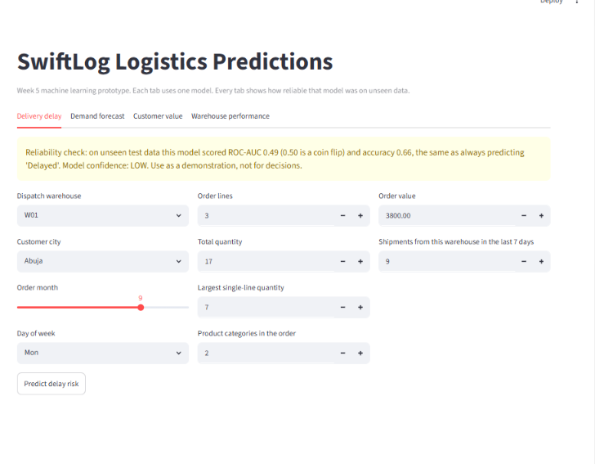
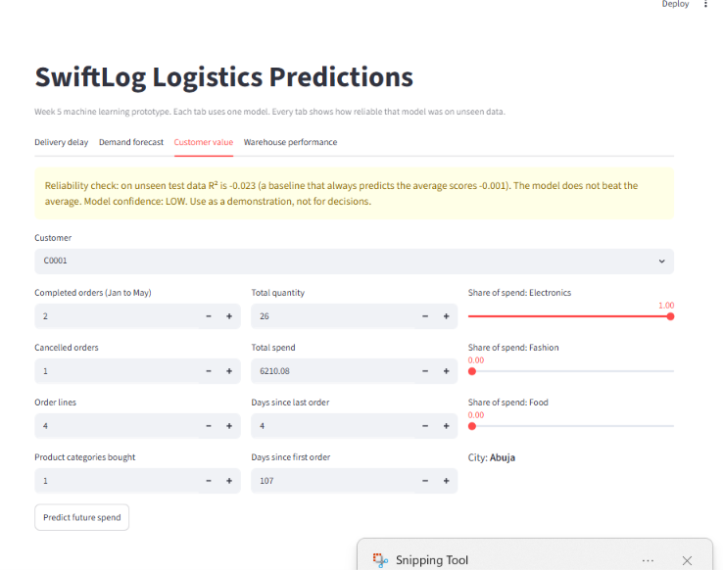
The prototype app shows its own reliability warning
Streamlit app with four tabs, one per problem.
Each tab shows a banner with the model's real test result against its baseline.
Run it with: streamlit run App/app.py
Treat it as a prototype for exploration, not for decisions.
Models are saved in Models/Best_Model.pkl as four bundles (pipeline, features and, for delay, the 0.37 threshold). Deploying this app into operations is deliberately not recommended until better data lifts performance above the baselines.
Notes:
Show the banner: the app tells the user how reliable each model really is.

